Slide 1
BASICS OF LICENSING: UPDATED
HISTORY OF LICENSING HIGHLIGHTS
© 2025 Kent Press

Slide 2
BIRTH OF LICENSING 18TH CENTURY

Slide 3
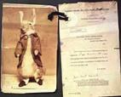
PETER RABBIT 1901
One of the most famous licensing characters of all time, PETER RABBIT, traces its origins back to 1901 when Beatrix Potter designed and patented a soft toy based on the PETER RABBIT character that had appeared in a book she wrote and self-published in 1901. In 1902, Ms. Potter entered into an agreement with the British publisher, Frederick Warne & Co., who then published a color version that same year. It is believed that PETER RABBIT was the first licensed character.

Slide 4
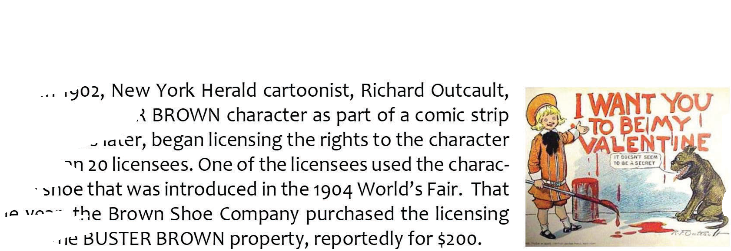
BUSTER BROWN
1902

Slide 5
TEDDY BEARS 1903

Slide 6
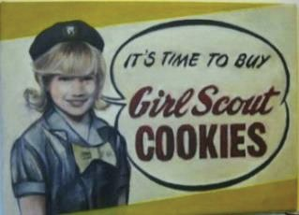
GIRL SCOUT COOKIES 1912
The GIRL SCOUTS (originally named Girls Guides of America) organization was founded in 1912 and soon, thereafter, began licensing its name for a line of “Official” GIRL SCOUTS products. It is believed that over the years, the mark has appeared on more than 1800 different products, including the famous GIRL SCOUTS cookies

Slide 7
RAGGEDY ANN & ANDY 1920

Slide 8
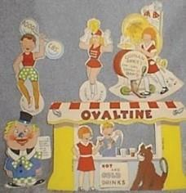
LITTLE ORPHAN ANNIE 1924
LITTLE ORPHAN ANNIE was created by Harold Gray in 1924 and first appeared as a comic strip in the Chicago Tribune. The comic strip was published for more than 80 years by Tribune Media Services until the final installment appeared on June 13, 2010. In 1924, a LITLLE ORPHAN ANNIE radio show was launched with Ovaltine as its sponsor.

Slide 9
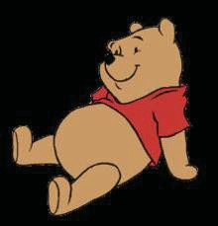
In 1926, A.A. Milne published in England the first of what would become a series of books on the adventures of WINNIE THE POOH. The books met with moderate success but when a U.S. based licensing agent, Stephen Slesinger, acquired the U.S. and Canadian licensing, tel- evision and recording rights to the character in the early 1930’s, a licens- ing legend was born. Slesinger, a licensing pioneer, immediately launched an aggressive licensing program around the character that
would reportedly generate more than $50 million in licensing revenues. In the 1940’s, POOH became the first Sunday morning television cartoon series. Disney acquired all rights to the character in 1961 and, soon thereafter, entered one of the first direct to retail licenses with Sears for the property. Today, POOH is a global icon and thousands of differ- ent POOH licensed products are sold around the world. POOH was the winner of LIMA’s License of the Year Award in 1996 and possibly the most famous licensing character of all time.

Slide 10
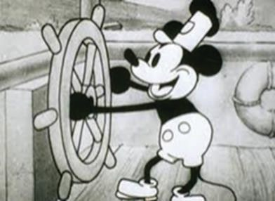
MICKEY MOUSE was created by Walt Disney and Ub Iwerks on November 28, 1928, as a replacement for another Disney character, OSWALD THE LUCKY RABBIT. The character was based on a cartoon called STEAMBOAT WILLIE that had appeared earlier that year. Disney didn’t waste any time in licensing the character for a variety of merchandise, including a license to Waldburger, Tanner in Switzerland for MICKEY & MINNIE handkerchiefs. MICKEY MOUSE would go on to become a corporate icon for Disney and is recognizable in virtually every country in the civilized world.

Slide 11
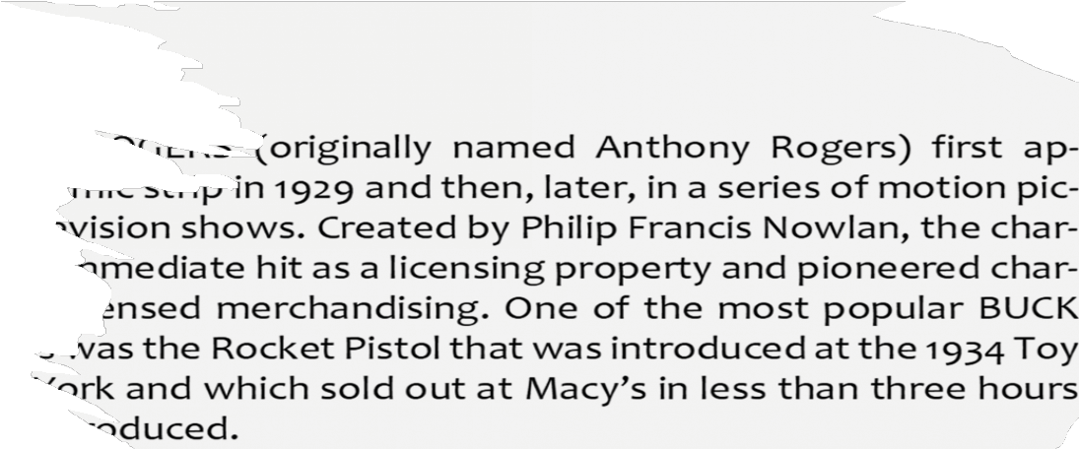
BUCK ROGERS 1929

Slide 12
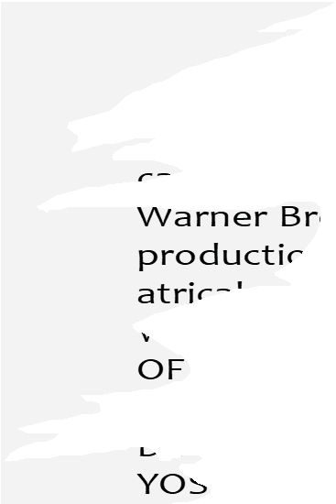
LOONEY TUNES 1930

Slide 13
SUPERMAN 1932

Slide 14
DC COMICS 1934

Slide 15
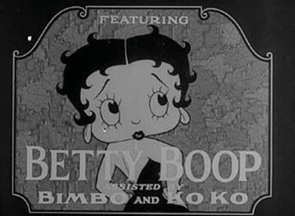
BETTY BOOP 1935
BETTY BOOP is an animated cartoon character created by Max Fleischer with help from animators including Grim Natwick. She originally appeared in the talkartoon and Betty Boop film series, which were produced by Fleischer Studio and released by Paramount Pictures. She has also been featured in comic strips and mass merchandising.

Slide 16
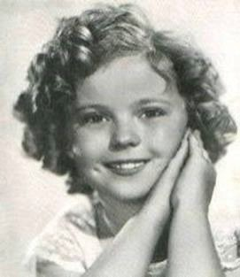
SHIRLEY TEMPLE 1935
The child actress, SHIRLEY TEMPLE, began her career in 1932 and it immediately skyrocketed. In 1935, she received a special Academy Award and would go on to star in such blockbusters as Curly Top and Heidi. Her licensing program quickly followed. She was reported to have made more than $100,000 in royalties before 1935 and her licensing income for 1936 was reportedly more than $200,000. Ideal Toy produced the first SHIRLEY TEMPLE doll in the 1930’s and it is believed that more than $41 million of these dolls were sold by 1941.

Slide 17
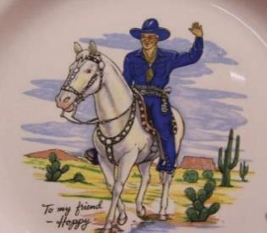
HOPALONG CASSIDY 1935
HOPALONG CASSIDY, played by William Boyd, first ap- peared on the big screen in 1935 and achieved immediate success. The character was originally created in 1904 by Clarence E. Mul- ford as part of a series of books, but it was Boyd’s film version in 1935 that would popularize it. Boyd appeared on the covers of Look, Life, and Time and, reportedly, earned millions of dollars from licensing and endorsement deals. It is believed that
HOPALONG CASSIDY was the first character ever licensed for a child’s lunch box and more than 600,000 licensed lunch boxes were reportedly sold in the first year of sales. By 1950, there were more than 100 HOPALONG CASSIDY licensees selling more than $70 million in licensed products.

Slide 18
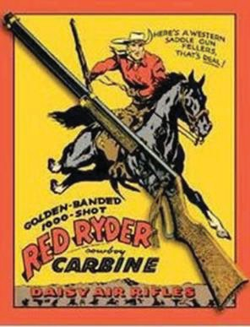
RED RYDER 1938

Slide 19
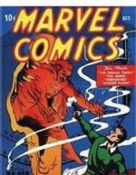
MARVEL COMICS 1939
MARVEL COMICS, which would ultimately become a major force in licensing, was formed in 1939 by Martin Goodman. Its first publication, entitled MARVEL Comics TORCH. MARVEL would go on to develop some of the most famous superhero characters in the industry #1, appeared in October 1939 and introduced several new superheroes, including, the HUMAN, many of which were extensively licensed and adapted for motion pictures and television. Some of its most famous superhero characters include SPIDER-MAN, IRON MAN, X-MEN, WOLVERINE, the HULK, FANTASTIC FOUR, CAPTAIN AMERICA, and GHOST RIDER.

Slide 20
BATMAN 1939

Slide 21
ARCHIE COMICS 1941

Slide 22
THOMAS THE TANK ENGINE 1946
THOMAS THE TANK ENGINE, a fictional locomotive, first appeared in 1946 in a se- ries of books by Rev. W. Awdry and his son, Christopher. The property would lay somewhat dormant, however, until 1979 when a British pro- ducer named Britt Allcroft discovered it and invested all her life savings to turn the character into a television series called Thomas the Tank En- gine and Friends (later, Thomas and Friends, with Ringo Starr as the nar- rator). The television series and resultant licensing program were im- mediate hits and THOMAS has been licensed for a wide range of prod-
ucts ranging from toy trains to videos, books, apparel and toys. It was LIMA’s License of the Year for 1993.

Slide 23
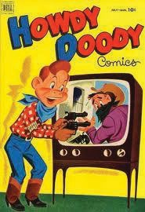
HOWDY DOODY 1947
The HOWDY DOODY show was one of the most popular children’s television shows from 1947 until 1960. Created by Bob Smith, Martin Stone, Allan Stone and Roger Muir, it featured a red-headed, freckled face puppet named HOWDY DOODY who was an outgrowth of puppeteer Frank Paris and host Buffalo Bob Smith. Rhoda Mann built the puppet and was its op- erator. It was one of the first shows to be broadcast in color and, because of its enormous popularity, was heavily merchandised by Allan Stone. In
1955, for example, its producers published a 24-page catalog that featured such licensed products as puppets, various food products including apples and kale, toys and clothing, comic books and other publications. Howdy Doody even ran for president in 1948 sup- ported by “Howdy Doody for President” buttons.

Slide 24
NASCAR 1947
In 1947, Bill France, Sr. created the National Association for Stock Car Auto Racing (NASCAR). It would eventually become the largest sanctioning body of stock car racing in the world and the sponsor of the three largest racing series. NASCAR currently sanctions over 1500 races in more than 100 racetracks throughout the United States, Canada, Japan, Mexico and Australia. Its 75 million fans purchase over $1 billion of licensed NASCAR products every year, most notably Apparel and die-cast autos.

Slide 25
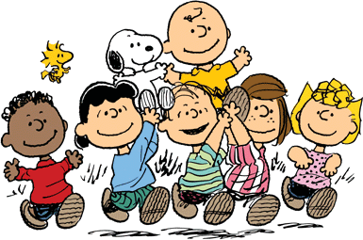
PEANUTS COMIC STRIP
1950
The 1950’s
The decade commenced with the creation of PEANUTS, which would become one of the most popular licensing properties of all time. Based on a syndicated comic strip created by Charles M. Schulz, it featured CHARLIE BROWN, SNOOPY and LUCY. The strip ran for almost 50 years until Schultz’s death in 2000, with 17,897 strips published during that period. At its peak, the comic strip had a readership of 355
million in 75 different countries in 21 languages. It was reported that the strip and the related licensing earned Schulz more than
$1 billion. PEANUTS characters have been licensed for virtually every product imaginable on earth….and beyond. NASA’s Apollo 10 lunar module was named SNOOPY and the command module was named CHARLIE BROWN.

Slide 26
LES PAUL GIBSON GUITAR 1952

Slide 27
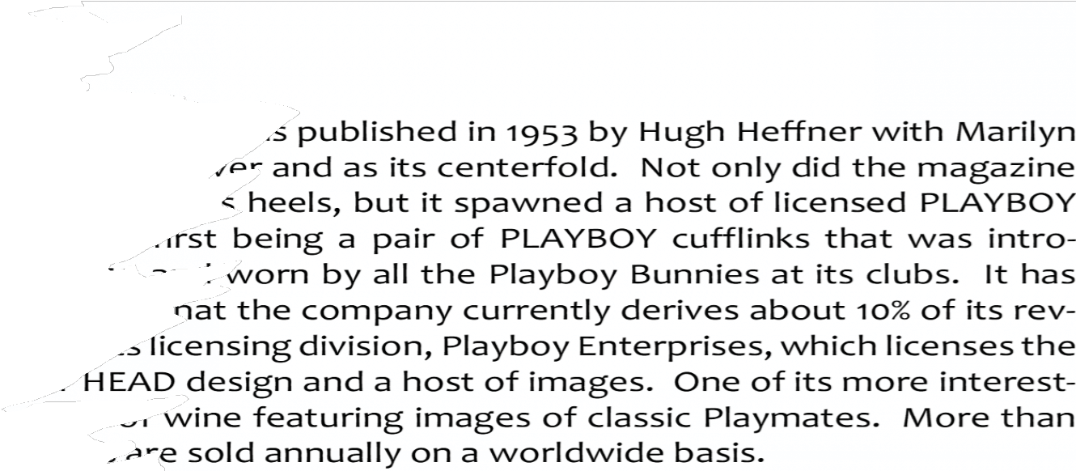
PLAYBOY MAGAZINE 1953

Slide 28
JAMES BOND 1953
The JAMES BOND 007 character was created by writer Ian Fleming in 1953 and was later featured in twelve novels and 22 motion pictures, the longest running of which was the 1962 feature Dr. No. The licensing pro- gram started at LCA with “Goldfinger” and LCA represented it for many years. The JAMES BOND 007 character was heavily licensed, particularly for toys, comic books, men’s cologne and video games. The first video game was released in 1983 by Parker Brothers for the Atari, Commodore
and Colecovision platforms. Other JAMES BOND video games have been produced by Elec- tronic Arts and Activision based on Goldeneye 007.

Slide 29
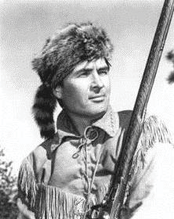
DAVY CROCKETT TV SHOW 1954
In the 1950’s, ABC Television popularized the American frontiersman, DAVY CROCKETT, in a series of television shows and a motion picture starring Fess Parker. While the show and movie were moderately successful, the sales of licensed DAVY CROCKETT products sold extraordinarily well. At its peak, it was reported that DAVY CROCKETT coonskin caps were selling at the rate of 5,000 per day. More than
$300 million of licensed products were sold by 1955 and, by 2001, licensed sales topped $2 billion.

Slide 30
ANNIE OAKLEY TV SHOW 1954

Slide 31
ELVIS PRESLEY 1954
Without question, one of the most extensively licensed properties of all time is ELVIS PRESLEY who hit the world stage in 1954 and would go on to redefine the meaning of success for a celebrity license both before and after the singer’s death. Called the "King of Rock and Roll," ELVIS PRESLEY became a pop icon and is the best- selling solo artist of all time. His licensing program has been equally successful. Elvis Presley Enterprises licenses all ELVIS related properties, including his name, image and voice, song titles such as Blue Suede Shoes, Jailhouse Rock and Hound Dog and words and phrases that have become associated with ELVIS, including GRACELAND, TCB and KING OF ROCK AND ROLL. It’s been reported that Elvis Presley Enterprises’ licensing revenues in 2009 (more than 30 years after his death) were $24.3 million.

Slide 32
KERMIT THE FROG 1955

Slide 33
LOS ANGELES RAMS LICENSING 1956
Sports licensing really began to take hold in the 1960’s due, in large part, to the efforts of Pete Rozelle who, in 1956, became General Manager of the then Los Angeles Rams. Rozelle recognized the licensing potential of the LOS ANGELES RAMS name and logo and aggressively sought licensees for a variety of different licensed products to both help promote the team and to raise additional revenue. Rozelle’s genius was quickly recognized. In 1959, he would become Commissioner of the National Football League. Rozelle oversaw the development of one of the most successful professional sports leagues in the world, with a licensing program that quickly emerged as a model for all other sports to follow.

Slide 34
HANNA-BARBERA PRODUCTIONS 1957
HANNA-BARBERA Productions was formed in 1957 by animation directors William Hanna and Joseph Barbera, in partnership with Columbia Pictures and would go on to dominate American television animation for fifty years, producing such successful cartoon shows as the FLINTSTONES, SCOOBY-DOO, YOGI BEAR SHOW, JETSONS and the HUCKLEBERRY HOUND show.

Slide 35
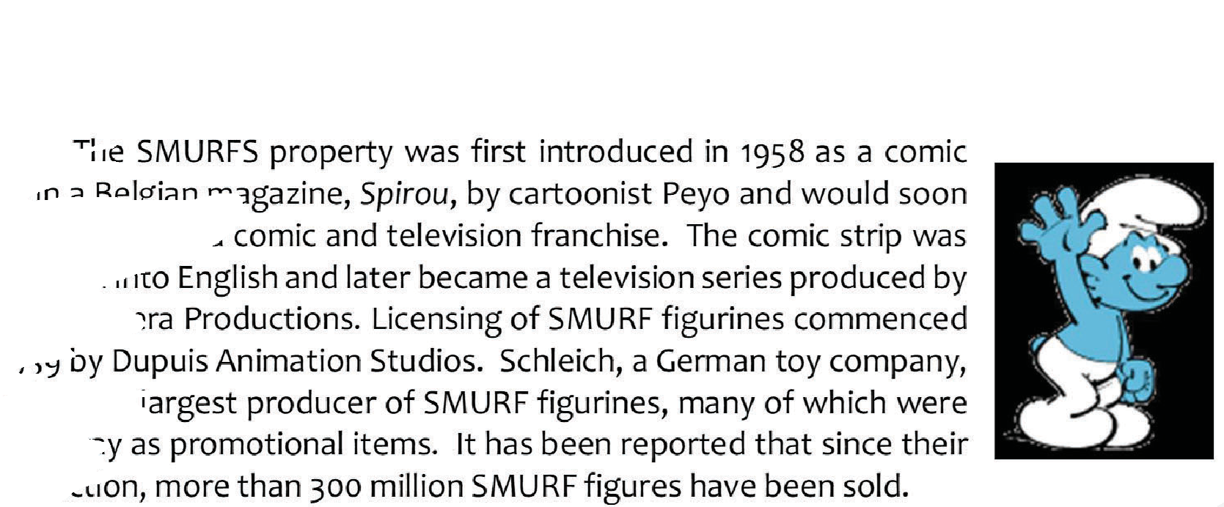
SMURFS 1958

Slide 36
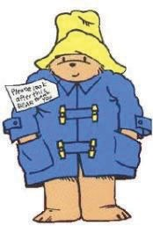
PADDINGTON BEAR
1958
PADDINGTON BEAR, that polite fictional bear with a hat and suitcase who loves marmalade sandwiches, made his first appearance in 1958 in the first of a series of books written by Michael Bond and illustrated by Peggy Fortnum. The books would eventually be published in more than 30 languages and sell more than 30 million copies. Over the years, it is reported that more than 265 licenses were granted for PADDINGTON products in virtually every civilized country in the world. The character was so popular in Eng- land that the character was featured on a coin and postage stamp.

Slide 37
BARBIE
1959
The 1950’s closed out with the launch by Mattel of the first BARBIE doll at New York Toy Fair in March 1959. BARBIE was designed by Ruth Handler and was marketed as a “Teen-age Fashion Model.” The reception was extraordinary, as product literally flew off retailers’ shelves. Mattel sold more than 350,000 units in the first year after introduction. BARBIE would go on to become a cultural icon—a section of Times Square in New York City was named Barbie Boulevard for a week and Andy Warhol created a painting of the character. It has also become a licensing franchise, and the BARBIE property has been li- censed for virtually every conceivable type of licensed product. There are even pop-up BARBIE stores in cities around the world.

Slide 38
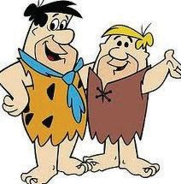
THE FLINTSTONES TV SHOW 1960
The 1960’s
The 1960’s opened with the debut of the FLINTSTONES, an an- imated television sitcom produced by Hanna-Barbera which ran from September 1960 until April 1966. It portrayed a working class, stone- age family headed by Fred Flintstone, his wife Wilma, and their neigh- bors, Barney and Betty Rubble. Many believe that it was an animated satire of the Honeymooners and was one of the first television shows ever to be broadcast in color. The FLINTSTONES licensing program
pursued new and different types of licensed products. For example, Miles Laboratories developed a line of children’s FLINTSTONE vitamins in the shape of the show’s characters and Post Foods sold a line of PEBBLES cereals that are still being sold today.

Slide 39
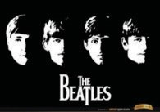
THE BEATLES 1960
1960 was also the year that John Lennon, Paul McCartney, George Harrison and Ringo Starr joined forces in Liverpool, England to form the what would become the most successful rock group of all time the BEATLES. Almost immediately, the group was a household name, both musically and in licensing. Their opening song, I Want to Hold Your Hand, sold more than 2.6 million copies in the United States during a two-week period and their initial appearance on The Ed Sullivan Show had a 40 percent market share. BEATLES merchandise sold as fast as the group’s music. It was estimated that Americans spent $50 million in 1964 for licensed BEATLES merchandise. Remco Toys ramped up to manufacture 100,000 BEATLES dolls but received orders for an additional 500,000, while Lowell Toy sold BEATLES wigs at the rate of 35,000 per day. Some considered BEATLES licensing as the biggest marketing opportunity since Disney created MICKEY MOUSE.

Slide 40
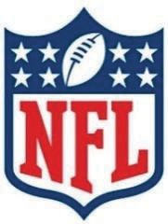
NATIONAL FOOTBALL LEAGUE 1963
In 1963, the National Football League formed a wholly owned subsidiary called NFL Properties and charged it with the responsibility for licensing the name and
logos of its teams and related properties, including the soon to be created
SUPER BOWL. It was the first licensing division of any professional sports league. In time, NFL Properties would become one of the most dominating sports licensing groups in the world, with retail sales of licensed NFL prod- ucts believed to top $3 billion. The other sports leagues soon followed suit—MLB Properties was formed in 1966 and NBA Properties was formed in 1967.

Slide 41
CLIFFORD THE BIG RED DOG 1963
Scholastic Books published the first of what would become the CLIFFORD THE BIG RED DOG book series in 1963. Written by William Bridwell, the series was at least partially responsible for launching Scholastic as a major publisher. The featured character, CLIFFORD, entered life as the runt of the litter but would grow to over 25 feet long because of his owner’s love. CLIFFORD would be featured in videos, as a television series and on a host of different licensed products.

Slide 42
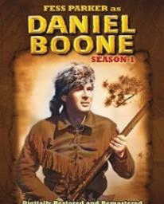
DANIEL BOONE TV SHOW 1964
The popularity of American folk heroes continued throughout the decade. In 1964, the television series Daniel Boone debuted, featuring Fess Parker as the main character, DANIEL BOONE. The show also starred country western singer Jimmy Dean and former football star, Roosevelt Grier and would remain on the air through 1970. Like the other shows involving folk heroes, it was heavily licensed.

Slide 43
HASBRO’S G.I. JOE 1964
G.I. JOE was introduced by Hasbro in 1964, originally as the Adventures of G.I. Joe, but later as simply G.I. JOE to downplay its war theme. The toy would go on to create the “action figure” category of toys. While G.I. JOE
characters are not all have special skills in
superheroes, per se, they martial arts, weapons and
explosives. The character has been used and licensed extensively by Hasbro and has evolved into comic books, motion pictures and video games.

Slide 44
ANPANMAN BOOK SERIES 1968
ANPANMAN, a fictional character created by Takashi Yanase, was introduced in Japan as a series of books in 1968. The character would ultimately become one of Japan’s most popular animated children’s cartoon series of all time. By 2006, more than 50 million ANPANMAN books have been sold in Japan and it was made into a television series. It is Japan’s most popular fictional character and has been licensed for a variety of products, including apparel, video games, toys and snack foods.

Slide 45
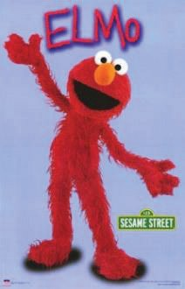
SESAME STREET TV SHOW 1969
One of the longest running children’s television shows of all time, SESAME STREET, premiered in 1969. Produced by Sesame Work- shop (originally Children’s Television Workshop), it has been a pioneer of contemporary educational television and was the first pre-school educa- tional television program to base its content on laboratory and forma- tive research. The show has developed and licensed such characters as OSCAR THE GROUCH, BIG BIRD, BERT, ERNIE and, of course, ELMO, all
of which have become household names. SESAME STREET’s first licen- see was Western Publishing which, in 1971, published the first of what
would become more than 600 individual titles based on the characters. SESAME STREET’s
biggest impact on licensing has been in the toy area, initially with Tyco Toys and subse-
quently with Mattel and Hasbro. SESAME STREET remains one of the strongest licensing brands of all time, reportedly with licensed product sales of more than $1.3 billion annually.

Slide 46
RALPH LAUREN’S POLO BRAND 1972
The 1970’s
The decade started off in a big way when New York fashion designer, RALPH LAUREN created his soon to be famous, POLO brand, as part of a line of women’s suits that he designed. In 1972, he introduced a short sleeved, mesh shirt with the POLO logo on it and a fashion industry fad was born. The shirt gained fame when it appeared in the motion picture, The Great Gatsby. By 2009, the RALPH LAUREN empire grew to more than $5 billion and it paved the way for other fashion designers such as PIERRE CARDIN, CALVIN KLEIN, GLORIA VANDERBILT and TOMMY HILFIGER.

Slide 47
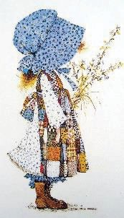
AMERICAN GREETINGS’ HOLLY HOBBIE 1972
In 1972, American Greetings introduced the HOLLY HOBBIE charac- ter which had been created by writer and illustrator of the same name who lived in New England and who had previously written a series of children’s books called Toot and Puddle. American Greetings bought her artwork that depicted a cat-loving, rag dress-wearing, little girl in a giant bonnet and a licensing legend was born. HOLLY HOBBIE was featured by American Greetings in a line of greeting cards and, in 1974, Knickerbocker Toys mar-
keted the first licensed HOLLY HOBBY product—a rag doll.

Slide 48
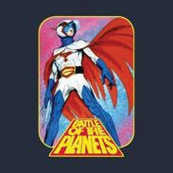
GATCHAMAN 19972
The animated series Science Ninja Team Gatchaman, or simply GATCHAMAN, was first produced in Japan in 1972 by Tatsunoko Productions. It involved a group of teens who helped protect the planet from an alien invasion. The property was adapted into several English language versions, including one by Sandy Frank Entertainment named the Battle of the Planets. The series would become a worldwide television hit and is rumored to have had an influence on George Lucas’ development of the STAR WARS property.

Slide 49
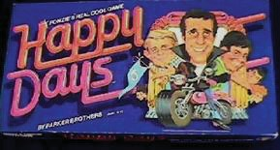
HAPPY DAYS TV SHOW
1974
By the mid-1970’s, Hollywood studios had discovered the power of licensing to generate additional revenue while helping to promote a motion picture or television show. Paramount Pictures was a leader in this area, having developed licensing programs for virtually all of their television series, including HAPPY DAYS, LAVERNE & SHIRLEY and MORK &
MINDY, as well as such motion pictures as STAR TREK and John Travolta’s first three motion pictures, SATURDAY NIGHT FEVER, GREASE and
URBAN COWBOY. These programs all
generated significant amounts of revenue for Paramount and created a model for other studios to follow.

Slide 50
HELLO KITTY 1975
HELLO KITTY, a fictional character designed by Yuko Shimizu, was first introduced in Japan by Sanrio in 1975 as a vinyl coin purse and, a year later, found its way into the United States. HELLO KITTY proved to be an immensely popular licensing property and more than $4 billion of licensed products are sold annually, ranging from dolls to stickers, greeting cards, apparel, accessories, school supplies, dishes and home appliances. There are currently two HELLO KITTY theme parks in Harmonyland and Sanrio Puroland, Japan.

Slide 51
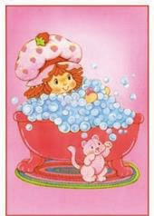
STRAWBERRY SHORTCAKE 1977
STRAWBERRY SHORTCAKE was created in 1977 by Muriel Fahrion while working as a greeting cards illustrator for American Greetings. Each of the characters had strawberry scented hair and lived in a world called Strawberryland. When American Greetings presented the concept to Bernie Loomis at Kenner Toys, a licensing phenomenon emerged. The success of the property led American Greetings to create its own licensing group, called Those Characters from Cleveland. Throughout the 1980’s, the character was licensed extensively and was the basis of several television specials. It was re-introduced with a different look in 2002 and, once again, became quite popular, particularly on toys, DVD’s and video games.

Slide 52
STAR WARS
1977
When the first STAR WARS motion picture was released on May 25, 1977, by Twentieth Century Fox, it set the licensing industry on its ear. Created by George Lucas, the STAR WARS film franchise would ultimately exceed $9 billion in box office revenues, which made the series the highest revenue producer of all time. While the movies were hits, the licensing success was unmatched by any property, either before or after. Bernie Loomis and Kenner Products were, once again, at the center of the licensing program, as the STAR WARS licensee for toys and action figures. When first introduced, Kenner could not manufacture product fast enough to meet consumer demand and it resorted to giving coupons to consumers for later redemption. From 1977 to 1985, Kenner sold more than 300 million STAR WARS action figures. In an industry where the word “franchise” is overused, the STAR WARS property is truly a franchise.

Slide 53
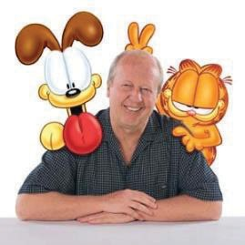
GARFIELD COMIC STRIP 1978
The GARFIELD character was born out of a comic strip of the same name that was first published by Jim Davis in 1978. It featured a quirky, but lovable, cat named after Davis’ grandfather as well as a dog called ODIE. By 2007, GARFIELD was syndicated in more than 2500 newspapers and journals and is considered the most widely syndicated comic strip of all time. GARFIELD has been featured on
television shows, in motion pictures and adapted for host of licensed products, most no- tably toys, plush and apparel products.

Slide 54
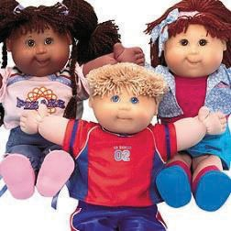
THE CABBAGE PATCH KIDS 1978
The CABBAGE PATCH KIDS were created by Debbie Morehead and Xavier Roberts in 1978. The dolls were originally sold at local craft shows in Cleveland, Georgia until Roger Schlaifer of Schlaifer Nance & Company stepped in. He re-named
them the CABBAGE PATCH KIDS, licensed the rights to Coleco Toys, and watched them become the hit of the 1982 holiday season. Stores could not keep sufficient inventory to meet demand. Lines formed outside of many stores that announced that they had received a ship- ment. After Coleco’s bankruptcy, Mattel, Hasbro and Play Along each marketed their own versions with modest success. It was reported
that at its peak, there were over 150 CABBAGE PATCH licensees for products ranging from diapers to cereal to apparel. In 1984 alone, it was reported that more than $2 billion of
CABBAGE PATCH products were sold at retail and, over its lifespan, retail sales were at least $4.5 billion.

Slide 55
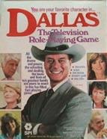
DALLAS TV SERIES 1978
The DALLAS television series was first aired in the fall of 1978 and would run through 1991. Produced by Lorimar Productions (and licensed by the co-author of this book) and starring Larry Hagman as J.R. Ewing, it was a primetime soap opera about an affluent Texas family in the oil and cattle ranching business. DALLAS was one of the first adult properties ever to be licensed and demonstrated that entertainment licensing was not all about children’s themes. The show paved the way for other adult merchandisable properties such as KNOTS LANDING, FALCON CREST and DYNASTY.

Slide 56
CORPRATE TRADEMARK LICENSING
1980’S
The 1980’s
It was during the 1980’s that major corporations began testing the waters, having recognized the advantages that licensing offered. Licensing assisted some companies in expanding the breadth of their trademark protection, while helping others promote the sale of their underlying products. Regardless of the reason for getting involved in licensing, all welcomed the additional revenue that it brought to their bottom line. Corporations with well-known brands such as COCA-COLA, HARLEY DAVIDSON, PEPSI,
COORS and JOHN DEERE all began to explore licensing activities with a significant amount of success. It was estimated, for example, that the COCA-COLA licensing program generated more than $70 million in net royalty income during its peak.

Slide 57
KENNER TOYS CARE BEARS 1981
The 1980’s
The CARE BEARS property was created by Elena Kucharik in 1981, originally for use on a line of greeting cards by American Greet- ings. Two years later, Bernie Loomis and Kenner Toys developed and began selling a line of plush products based on the characters and the licensing program was off to the races. A television series based on the characters ran from 1985 until 1988 and it was also featured in three motion pictures. The characters were re-introduced as toys in 2002 by Play Along Toys with modest success. The CARE BEARS property ush- ered in a new era in licensing—the birth of the half-hour, animated,
syndicated television series which was distributed to local television channels across the United States and abroad. Previously, the dominant platform for children’s programming was Saturday morning television that only aired weekly. Syndication of half-hour animated shows aired five times a week in after school time slots and provided greater exposure for their properties. The gamble with syndication paid off for a number of properties, includ- ing MASTERS OF THE UNIVERSE and MY LITTLE PONY and fueled the licensing industry for most of the 1980’s. The bubble would, however eventually burst, unfortunately at great cost to the producers.

Slide 58
BIRTH OF COLLEGIATE LICENSING 1982
In a bizarre twist, a 1982 court decision finding that Champion Products’ produc- tion of non-licensed UNIVERSITY OF PITTSBURGH clothing did not constitute trademark infringement, produced the exact opposite result. At the time of the decision, Champion
was selling more than $100 of as many as 10,000 different destroying any hope for the and logos, reasonable minds was reached. Champion fell in
million of apparel bearing the logos schools and colleges. Instead of colleges to license out their names prevailed, and a business solution line, recognized that these schools
and colleges had valid rights, and began to take licenses to use their marks on its products. Thus, the collegiate licensing industry was born.

Slide 59
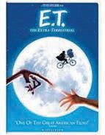
E.T. THE MOVIE 1982
E.T. was the blockbuster movie of 1982. Produced and directed by Steven Spielberg and written by Melissa Mathison, it was about a lonely boy who befriended an extraterrestrial called E.T. Box office sales skyrocketed, and, for a period, E.T. was the most financially successful motion picture of its time. While the E.T. character was heavily merchandised, it is perhaps best known for creating a concept called product placement, where a product is featured in the movie for the express purpose of promoting it. In E.T.’s case, that product was Hershey’s Reese’s Pieces which was portrayed as E.T.’s favorite candy.

Slide 60
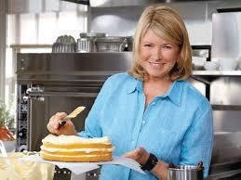
MARTHA STEWART’S BOOK “ENTERTAINING”
1982
In 1982, Crown Publishers published the first MARTHA STEWART book entitled En- tertaining, and an empire began. Ms. Stewart then collaborated with Time Publishing in 1990 to develop a magazine called Martha Stewart Living which would eventually enjoy a circulation of 2 million readers. That led to a series of successful television shows and spe- cials and, ultimately, the creation of the company, Martha Stewart Living Omnimedia, which would go public in 1999. Kmart has carried her licensed line of home furnishing products for decades and a licensed MARTHA STEWART line of paint is sold through Sears. It is now part of Sequential Brands.

Slide 61
MARY ENGELBREIT 1983
The 1970’s also saw the emergence of MARY ENGELBREIT who would pioneer the art licensing category. Engelbreit started out as a greeting card designer and illustrator working for an advertising agency in St. Louis. Her first success was a greeting card featuring a girl looking at a chair piled high with bows with the saying, “Life Is Just a Chair of Bowlies.” She granted her first art license later in the decade and has endured as a licensing success ever since, winning LIMA’s Art License of the Year in both 2001 and 2003.

Slide 62
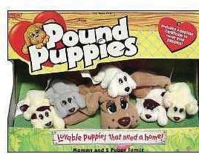
POUND PUPPIES 1983
POUND PUPPIES was created in 1983 by Mike Bowling, a former Ford factory worker who, when he saw the look of love on the face of his young daughter for one of her dolls, remembered that same feeling from his own childhood after going to the pound to pick out a pet. The first POUND PUPPIES doll was marketed in Canada in 1984 by Irwin Toys and, a year later, Tonka began mar- keting it in the United States. It would eventually generate more
than $300 million in sales in 35 different countries and spawn a wide range of licensed products.

Slide 63
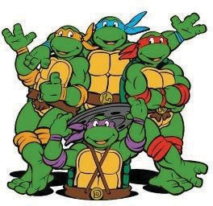
TEENAGE MUTANT NINJA TURTLES 1984
The TEENAGE MUTANT NINJA TURTLES was a
collaboration between Kevin Eastman and Peter Laird. Using money from a tax return, they formed Mirage Studios in 1984 and published a comic book that featured these
characters as a parody of MARVEL’s superheroes. It became enormously popular, principally because of the efforts of their licensing agent, Mark Freedman, who developed a licensing program with Playmates Toys. Throughout the 1980’s and 1990’s, TURTLE’s licensees produced a wide range of licensed products, and it was LIMA’s License of the Year in 1991.

Slide 64
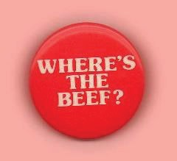
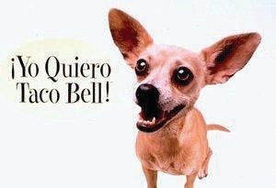
ARBY’S WHERE’S THE BEEF
&
TACO BELL’S CHIHUAHUA
1984
Not to be outdone, Arby’s restaurants launched a licensing pro- gram based on the catchy phrase WHERE’S THE BEEF. The phrase was licensed for a line of apparel and even found its way into the 1984 Vice- Presidential debate. The trend of licensing out catchy advertising slo- gans or characters has continued to this day, as evidenced by the licens-
ing program conducted by former LIMA chairman Brian Hakan, for the TACO BELL CHIHUAHUA, who had been featured in advertise-
ments for the restaurant. Similarly, the Mars Corporation regularly licenses the M&M’s characters that are featured in Mars’ television and print ads for its line of M&M’s candy products.

Slide 65
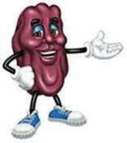
CALIFORNIA RAISINS 1986
By the mid-1980’s, licensing properties were coming from every imaginable source. A 1986 commercial for the California Raisin Advisory Board spawned a property that would receive LIMA’s award for the Most Impactful Property of the year in 1988—the CALIFORNIA RAISINS. These characters were featured in the commercial dancing to the Marvin Gaye song, “I Heard It Through the Grapevine.” With Applause as its primary toy licensee, sales of licensed products exploded. It was the first time that a commercial formed the basis for a licensing program.

Slide 66
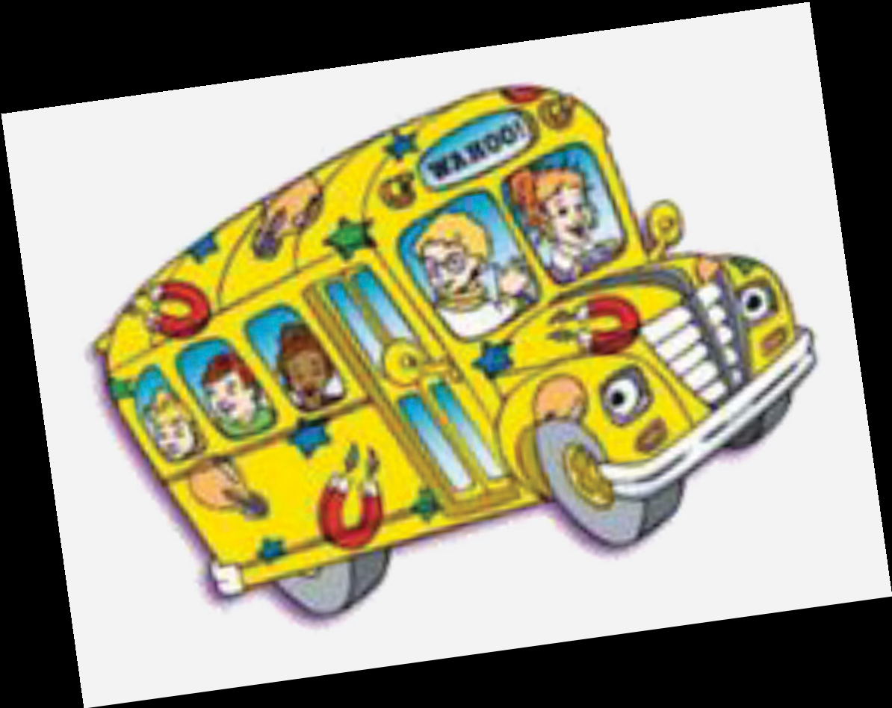
MAGIC SCHOOL BUS BOOK SERIES 1986
In 1986, Scholastic published the first of what would become a series of children’s books called the MAGIC SCHOOL BUS. These books were written by Joanna Cole and illustrated by Bruce Degan and featured an elementary school teacher, Mrs. Frizzle, who would take their readers on field trips to interesting places aboard a magical school bus. The books would eventually lead to a television series, a series of traveling museums and a very successful licensing program.

Slide 67
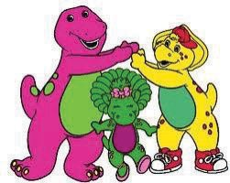
BARNEY THE DINOSAUR 1987
In 1987, Sheryl Leach of Dallas, Texas created the character BARNEY while over- seeing production of a series of home videos entitled Barney and the Backyard Gang starring Sandy Duncan. While the DVD’s were mod- estly successful, the character would ultimately be changed and be- came the basis for a PBS series that debuted in 1992 called Barney & Friends. The show was popular; however, its related licensing pro- gram was a real hit, particularly in the plush and toy areas. BARNEY
won LIMA’s License of the Year award in 1994.

Slide 68
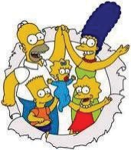
THE SIMPSONS 1989
THE SIMPSONS, an animated television series created by Matt Groening, debuted on Fox in 1989 and is still on the air, which makes it the longest running, scripted prime time television
show of all time. Featuring the characters HOMER, MARGE, BART, LISA and MAGGIE, it is a
spoof on American family life. THE SIMPSONS Movie was released in 2007 and grossed more than $525 million. Its enormous popularity has made it a licensing and media franchise, with the characters appearing on virtually every conceivable type of licensed product. By 2003, it was reported that there were more than 500 SIMPSONS’ licensees worldwide. In the first 14 months after release of the motion picture, it is believed that more than $2 billion of licensed merchandise were sold. A Fox executive called the SIMPSONS, “without a doubt, the biggest licensing entity that Fox has had, full stop, I would say from either TV or film.

Slide 69
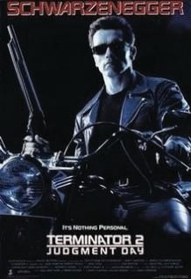
TERMINATOR 2: JUDGMENT DAY 1991
TERMINATOR 2: JUDGMENT DAY or simply T2, a science fiction motion picture directed by James Cameron and starring Arnold Schwarzenegger, was released in 1991 as a sequel to the original Terminator movie from 1984. It was one of the first “R” rated motion pictures to ever spawn a licensing program and has become the most successful licensed “R” rated film of all time. The licensing program, conducted by former LIMA President and co-author, Danny Simon, was led by Kenner Toys and Acclaim Entertainment. Universal Theme Parks also developed a licensed T2-3D attraction.

Slide 70
GOOSEBUMPS BOOK SERIES 1992

Slide 71
KATHY IRELAND WORLDWIDE 1993
KATHY IRELAND began her fashion career as a runway model and quickly began gracing the covers of the world’s most famous magazines, becoming a Supermodel and Fashion Icon. She would form Kathy Ireland Worldwide, which celebrated living and eclectic lifestyles by licensing fashions for women, men & children, intimate apparel, accessories, fine jewelry, weddings & resorts, etc. IRELAND was inducted into Licensing International’s Licensing Hall of Fame in 2022, the same year she was named one of Fairchild's 50 most influential people in fashion.

Slide 72
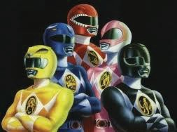
MIGHTY MORPHIN POWER RANGERS TV SERIES 1993
The MIGHTY MORPHIN POWER RANGERS,
which was based on a popular Japanese property called Kyōryū Sentai Zyuranger about four teenagers who were selected to fight evil, hit the television screens in 1993 as a live-action television series. It was produced by Haim Saban and immediately became an overnight hit—both as a TV show and licensing property. The series ran for three years and “morphed” into a feature motion picture called Mighty Morphin Power Rangers: The Movie.

Slide 73
POKEMON 1996
The POKÉMON property was created by Satoshi Tajiri in 1996 and launched by Nintendo that same year as a role-playing video game. It would become the second most successful video game-based franchise of all time, behind Mario Bros., selling more than 200 million copies. Under the watchful eye of LIMA Hall of Fame member Al Kahn at 4Kids Entertainment, it would also grow into a strong licensing property, with licenses for trading cards, apparel, books, and other media forms. POKÉMON was LIMA’s licensed entertainment character of the year in 2000.

Slide 74
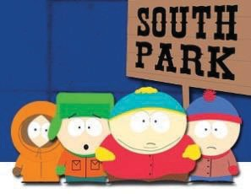
SOUTH PARK TV SERIES 1997
Comedy Central first broadcast its animated sitcom called SOUTH PARK in 1997 and, since its introduction, it has consistently earned the highest rating of any basic cable program. Created by Trey Parker and Matt Stone for an adult audience with satirical hu- mor, it focuses on four children and their adventures in a Colorado town. It is reported to generate several million dollars a year in roy- alties and licensed products include a pinball machine by Sega and
games and puzzles by Fun 4 All. In 1998, SOUTH PARK T-shirts were the largest selling specialty T-shirts in the United States.

Slide 75
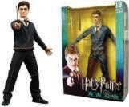
HARRY POTTER 1997
HARRY POTTER was introduced in June 1997 when J.K. Rowling’s first novel entitled HARRY POTTER and the Philosopher's Stone was published, describing the exploits of a young wizard, HARRY POTTER, and his friends at the Hogwarts School of Witchcraft and Wizardry. Over 400 million copies would be sold in 67 languages, making Rowling perhaps the only billionaire author. The Warner Bros. motion pictures have each achieved blockbuster status and are among the highest-grossing films ever. Licensing has been extensive, particularly in the toy, game, video, and costume areas, and a HARRY POTTER theme park was opened in Orlando, FL.

Slide 76
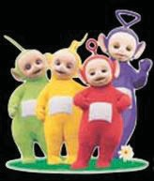
TELETUBBIES TV SERIES
1997
1997 also saw the TELETUBBIES property emerge. Created by Anne Woode and produced by Ragdoll Productions, it debuted in a BBC children’s television series of the same name. The program was aimed at pre-school viewers, although it drew adult viewers because of its humor. A total of 365 episodes were run in both the UK and the United States. The show received several broadcasting awards, and the property won LIMA’s Best Overall License of the Year award in 1999.

Slide 77
DORA THE EXPLORER TV SERIES 1999
DORA THE EXPLORER, an animated television series featuring Dora Marquez, first aired in September 1999 on Nickelodeon. The show, which was created by Chris Gifford, Valerie Walsh, and Eric Weiner, would continue until 2006 and be heavily merchandised along the way with DORA action figures, play sets, DVDs, cosmetics, hygiene products, ride-on toys, books, board games, plush dolls, apparel, handbags, play tents and play kitchens.

Slide 78
BOB THE BUILDER TV SERIES 1999
The animated CGI character, BOB THE BUILDER, was created by Keith Chapman and first appeared on the BBC in 1999. BOB is a building contractor who takes on various building projects, including renovations, construction and repairs. The show’s theme song, Can We Fix It, sold more than a million copies in the UK. The show has been extraordinarily popular and is aired in virtually every television market around the world and its licensing program, managed by HIT Entertainment, has been equally successful. The property was named as LIMA’s Entertainment/Character License of the Year in 2002.

Slide 79
SPONGEBOB SQUAREPANTS TV SERIES 1999
Another potentially classic property was introduced in 1999, when Nickelodeon launched the animated television series, SPONGE BOB SquarePants, created by Stephen Hil- lenburg. SPONGEBOB lives in an underwater city called Bikini Bottom. The
show would become Nickelodeon’s top-rated show and a feature film based on the character was released in 2004. Sales of licensed SPONGE- BOB merchandise have been very strong. It was reported that in 2002, sales of SPONGEBOB dolls sold at the rate of 75,000 per week. Other li- censed products include cereal, video games, clothing and electronics. The character has also been used extensively in promotional programs for vir-
tually every fast food and convenience store chain and by almost all major retailers.

Slide 80
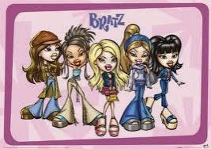
THE BRATZ DOLL LINE
2001
The 21st Century
The decade was not, however, all about movie licensing. The BRATZ doll, intro-
duced by MGA not only a very successful property. Trendy and cutting 125 million BRATZ dolls were global sales of all BRATZ 2001 through 2010, it is
Entertainment in 2001, proved to be doll but also a strong licensing edge, it was reported that more than sold in its first five years and, by 2005, products topped $2 billion. From believed that MGA had produced or
licensed more than 550 different BRATZ dolls and products. BRATZ was the winner of LIMA’s License of the Year award for 2004.

Slide 81
HAPPY BUNNY 2002
In 2002 artist Jim Benton came on the licensing scene in a big way with a smiling bunny called HAPPY BUNNY. Complete with catchy sayings, Carole Postal and COP Corp. developed a strong licensing program for the property covering a broad array of products, including key chains, computer mouse pads, energy drinks, school supplies, clothing, etc. HAPPY BUNNY was named LIMA’s Art Licensing Property of the Year in 2006.

Slide 82
MARVEL SUPERHERO MOVIE: SPIDERMAN 2002
Sony Pictures released three different SPIDERMAN motion pictures in the decade, all based on the original MARVEL characters. The original SPIDERMAN motion picture was released in 2002, SPIDERMAN 2 was released in 2004 and SPIDERMAN 3 in 2007. The trilogy grossed almost $2.5 billion at the box office and won multiple awards. All three motion pictures were heavily merchandised by Sony and SPIDERMAN and SPIDERMAN 2 received LIMA’s Best Overall License of the Year award for 2003 and 2005.

Slide 83
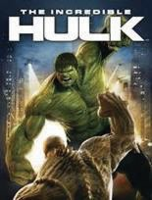
MARVEL SUPERHERO MOVIE: HULK 2003
Licensing in the New Millennium has tended to focus more on Hollywood’s “blockbuster” motion pictures, many of which were based on characters
developed example,
in the prior century. For two HULK motion pictures,
based on the MARVEL superhero, were released, the first in 2003 and the sequel in 2008. The 2003 release earned
$62.1 million in its opening weekend and would go on to gross almost $250 million worldwide. The sequel, The Incredible Hulk, out-grossed the original, with worldwide box office receipts of more than $263 million, and another $60 million in DVD sales. As would be expected, the sales of licensed products based on both motion pictures were strong.

Slide 84
STAR WARS: REVENGE OF THE SISTH
2005
LIMA’s award for the Best Overall License of the Year for 2006 went to STAR WARS: Episode III Revenge of the Sith which was released in 2005 and would be the latest episode of the STAR WARS
movies. All were written and
and The
directed by George Lucas produced by Lucasfilm Ltd.
film broke a number of box office records and would ultimately gross almost $850 million, placing it behind only the highest grossing film of 2005, Warner Bros.’ blockbuster, HARRY POTTER and the Goblet of Fire. Both motion pictures continued their history of strong licensing programs

Slide 85
PEPPA PIG TV SERIES 2005
The British animated pre-school animated television series PEPPA PIG took a while to capture the attention of the licensing industry but by 2010 more than £200M of licensed products had been sold in the UK. As of 2018, the property had been licensed to more than 60 licensees on a worldwide basis.

Slide 86
JESSICA SIMPSON BRAND 2005
The New Millennium also saw the emergence of a host of celebrities who licensed their names, images and likenesses for a wide variety of licensed products, some with extraordinary success. One of the most successful celebrity programs of the decade was the JESSICA SIMPSON brand program which, through the efforts of her master licensee, the Camuto Group (headed by Vince Camuto of NINE WEST fame), become a billion-dollar brand at retail before being acquired by Sequential Brands which also owned and
controlled the licensing STEWART, ELLEN TRACY
LAGASSE, among other.
of MARTHA
and EMERIL

Slide 87
PLEASANT GOAT AND BIG BIG WOLF
2005
The property PLEASANT GOAT AND BIG BIG WOLF, a Chinese animated television series, was launched in China in 2005. Created by Huang Weiming, Lin Yuting and Luo Yinggeng, it is broadcast on more than 40 local television stations and almost 1000 episodes have been aired. The first motion picture based on the television series was re- leased in 2009 and set a box office record in China for a Chinese ani- mated film, earning more than $8 million during the opening weekend. A second movie was released in 2010. It is one of the most popular li-
censed characters in China.

Slide 88
THE OLSEN TWINS BRAND 2006
The OLSEN TWINS, Mary Kate & Ashley, joined Simpson on the billion-dollar level mostly through their line of classic li- censed apparel and accessory products, initially through Walmart. While in their 20’s, Forbes estimated that their net worth in 2007 was more than $300 million due, principally, to the licensing empire that they have helped establish through the efforts of The Beanstalk Group.
Other celebrities, including JACKIE SMITH, JENNIFER LOPEZ, BRITANY SPEARS, DAVID BECKHAM, CINDY CRAWFORD, LADY GAGA, have all entered the licensing arena with varying degrees of success, mostly good.

Slide 89
PIXAR MOVIE CARS 2006
Disney’s blockbuster motion pictures, PIXAR CARS and HIGH SCHOOL MUSICAL, won LIMA’s Entertainment License of the Year awards for 2007 and 2008, respectively.
PIXAR CARS was directed by John Lasseter and Joe Ranft and featured the voices of prominent Hollywood actors, including Paul Newman and Michael Keaton. PIXAR CARS premiered in May 2006 at Lowe’s Motor Speedway in North Carolina and the related licensing program was nothing short of sensa- tional. It was reported that retail sales of licensed merchan-
dise, including scale models of its cars, broke records for a Disney-Pixar film with more than
$5 billion of licensed products sold. The New York Daily News reported that sales of its licensed merchandise were $600 million just two weeks after its release.

Slide 90
HIGH SCHOOL MUSICAL TV SERIES 2007
HIGH SCHOOL MUSICAL 2, which was the sequel to the Disney Channel Original Movie, HIGH SCHOOL MUSICAL, debuted on the Disney Channel in 2007 to 17.3 million viewers-- about 10 million more than for the original movie. That made it the most highly viewed Disney Channel movie to date. Ultimately, HIGH SCHOOL MUSICAL 3: SENIOR YEAR was released the following year in theatrical distribution.

Slide 91
BAKUGAN TV SERIES 2007
BAKUGAN, a Japanese animated television series produced by TMS Entertainment and Japan Vistec, debuted in 2007 in Japan and soon became popular in the United States and Canada. Not surprisingly, it spawned a line of licensed games led by Spin Master as its major toy licensee. Other licensed products included branded digital cameras, alarm clocks and other electronic products. BAKUGAN was selected by LIMA in 2009 as the Best Overall Licensed Program of the Year.

Slide 92
BATMAN MOVIE THE DARK KNIGHT 2008
The Hollywood Blockbuster formula of superhero movies continued throughout the decade. In 2008, Warner Bros. released a sequel to its 2005 BATMAN Begins motion picture, entitled the DARK KNIGHT, which was written and directed by Christopher Nolan. It set box office records everywhere and would become the seventh largest grossing movie of all time which, no doubt, contributed to its success as a licensing property.

Slide 93
TRANSFORMERS: REVENGE OF THE FALLEN
2009
The trend of licensing blockbuster movies continued into 2009, first with the re- lease of Paramount’s TRANSFORMERS: REVENGE OF THE FALLEN which brought in more than $400 million at the domestic box office followed by Fox’s release
of AVATAR in 2009 which produced more than $750 million at the box office. Both motion pictures have generated strong licensing pro- grams. It was reported that Hasbro, which owned the rights to TRANSFORMERS, had over 220 licensees for products across virtually all categories while Fox had over 125 licensees for the AVATAR prop- erty across at least four major categories, including video games, toys, apparel and publishing.

Slide 94
MICHAEL JORDAN INDUCTED TO BASKETBALL HALL OF FAME 2009
Perhaps the best-known celebrity licensors of all time are former basketball player MICHAEL JORDAN and golfer TIGER WOODS. While MICHAEL JORDAN continues to remain a licensing heavyweight, principally because of his relationship with Nike, the TIGER WOODS experience demonstrates the risks of celebrity licensing. WOODS, who reportedly earned almost $100 million in endorsement and licensing deals in 2009 and 2010, saw his golf score rise sharply while his licensing income fell precipitously after charges of his marital infidelity were made public.
Other prominent sports stars who earn significant sums through licensing and endorsements include fellow golfer SCOTTIE SCHEFFLER, basketball superstar LEBRON JAMES, baseball stars AARON JUDGE, SHOHEI OHTANI, and CLAYTON KERSHAW, football
players PATRICK MAHOMES, and TRAVIS KELCE., tennis player
ARYNA SABALENKA and soccer star LIONEL MESSI

Slide 95
ANGRY BIRDS VIDEO GAME 2009
ANGRY BIRDS is a video game franchise created by a Finnish company, Rovio Entertainment. By 2015, more than 3 billion copies of the game had been downloaded. It expanded to motion pictures and, ultimately, licensing, becoming the hottest licensing property in 2012. Activision’s SKYLANDERS, which was introduced in 2011, enjoyed similar success. By 2016, over 300 million toys had been sold, and the franchise has become the 11th biggest console franchise of all time.

Slide 96
DUCK DYNASTY TV SERIES 2012
One of the more unusual properties that captured the public’s attention, albeit for a relatively short period of time, was DUCK DYNASTY which emanated from a reality television show in the A&E Channel of the same name where it broke several ratings records. Sales of mostly adult licensed products topped $400 million by 2014, primarily in Walmart.

Slide 97
FROZEN MOVIE 2013
Disney has host of motion
dominated pictures
the New Millennium with a including PIXAR CARS, HIGH FROZEN and, after its current generation of STAR THE FORCE AWAKENS and
SCHOOL MUSICAL, TOY STORY,
acquisition of Lucasfilm, the WARS, including STAR WARS:
ROGUE ONE: A STARWARS STORY properties which dominated the merchandising stage in rapid fire succession.

Slide 98
PAW PATROL TV SERIES 2013
Spin Master Entertainment’s CGI animation series, PAW PATROL came on the scene in 2013 with Nickelodeon’s support. The series focuses on a boy named Ryder who led a pack of search and rescue dogs known as the PAW Patrol. The property accounted for more than 40% of Spin Master’s revenues in 2016 and the toy line, introduced by Spin Master, quickly climbed to the top of the charts in the US, UK and France. Toys “R” Us listed the PAW Patroller vehicle as the “hottest” selling toy in 2015.

Slide 99
/SKYLANDERS 2011
Activision’s SKYLANDERS, which was introduced in 2011, enjoyed similar success. By 2016, over 300M toys had been sold, and the franchise became the 11th biggest console franchise of all time.

Slide 100
DISNEY PURCHASE OF LUCASFILM
2012
In 2012 Disney acquired Lucasfilm for
$4.05B, including the rights to all STAR WARS films and the franchise. Since the acquisition, Disney has released several new STAR WARS films, TV shows, theme park attractions, and other forms of entertainment. It is believed that Disney has seen a 2.9 return on its investment.

Slide 101
L.O.L SURPRISE!
2016
MGA Entertainment launched its L.O.L. SURPRISE! ("Lil Outrageous Littles") toy line launched in 2016, becoming the #1 toy in the US. The main collectible series of the L.O.L. Surprise! Dolls are the Mystery Capsules. Each doll includes several surprises based on one theme. The brand was expanded in 2019 and 2020 by adding fashion dolls. It received awards from Licensing International in 2018 and 2019.

Slide 102
BLUEY 2018
BLUEY is an Australian animated preschool TV series premiered on ABC Kids in 2018. Created by Joe Brumm, it was commissioned by the Australian Broadcasting Corporation and the BBC, which retains distribution and merchandising rights. It features Bluey Heeler, a 6-year-old puppy who lives with her archeologist father, Bandit, and her mother, Chilli. It premiered on Disney Junior in the US and has won multiple licensing awards from Licensing International.

Slide 103
2009
Squishmallows is a stuffed toy launched in 2017 by Kelly Toys and is currently owned by Jazwares. They are round and come in over 3000 styles in various colors and sizes. Jonathan Kelly conceived the idea after a trip to Japan, then formed a strategic partnership with Kelly Toys in 2019 to "reinvigorate” the old Russ Berrie line. Jazwares acquired the rights in 2020. It gained success during the Pandemic in 2021. The brand had more than 13B views on TikTok and has won multiple licensing awards from Licensing Internation.

Slide 104
TAYLOR SWIFT BECOMES A BILLION DOLLAR 2034
By far, the most visible and successful celebrity is TAYLOR SWIFT. She has sold over 52 million albums, including 37 million in the US. She is one of the world's best-selling music artists. She is the highest-earning female musician of the 2010s and 2020s. She is not just a global music sensation but a masterful brand builder, strategically using trademarks to protect and grow her brand,
securing her position as one of
the most She has
influential artists in the world.
trademarks for various goods and services, including clothing, accessories, and Christmas stockings. This allowed her to capitalize on her brand's popularity in different markets and create multiple revenue streams. Forbes estimated Swift's 2024 net worth at $1.6B and believed she grossed over $1.15B before taxes.

Slide 105
LIMA / LICENSING INTERNATIONAL PROPERTIES OF THE YEAR
1989 - 2023

Slide 106
PROPERTIES NAMED LIMA / LICENSING INTERNATIONAL LICENSE OF THE YEAR
1989 - 2015
1989: CALIFORNIRAISINS
1990: BATMAN
1991: TEENAGE MUTANT NINJA TURTLES
1992: THE LITTLE MERMAID
1993: THOMAS THE TANK
1994: BARNEY & FRIENDS
1995: LION KING
1996: WINNIE-THE-POOH
1997: GOOSEBUMPS
1998: RUGRATS
1999: TELETUBBIES
2000: POKEMON
2001: POWERPUFF GIRLS
2002: BOB THE BUILDER
2003: SPIDERMAN
2004: BRATZ
2005: SPIDERMAN 2
2006: STAR WARS
2007: PIXAR CARS
2008: HIGH SCHOOL MUSICAL
2009: BAKUGAN
2010: THE TWILIGHT SAGA: NEW MOON
2011: TOY STORY 3
2012: ANGRY BIRDS
2013: SKYLANDERS
2014: DUCK DYNASTY
2015: FROZEN

Slide 107
PROPERTIES NAMED LIMA / LICENSING INTERNATIONAL LICENSE OF THE YEAR
2016-2023
*2016: STAR WARS: THE FORCE AWAKENS, PEPPA PIG, GIRL SCOUTS 2017: ROGUE ONE: A STARWARS STORY, PAW PATROL, GIRL SCOUTS
2018: VERY HUNGRY CATERPILLAR, DEAR DREW, LOL SURPRISE, PANTONE, EMOJI, RICK & MORTY, JOJO SIWA, GUINNESS, WWE
2019: VERY HUNGRY CATERPILLAR, FORTNITE, GOODYEAR, LOL SURPRISE, HARRY POTTER, HERSHEY REESE’S, NFLPA
2020: V&A, BROWN & FRIENDS; CAT, PEPPA PIG, SESAME STREET, COCA-COLA, RUGBY WORLD CUP
2021: VERY HUNGRY CATERPILLAR, SUPER MARIO, GOODYEAR, PEPPA PIG,
HARRY POTTER, COCA-COLA, NFLPA
2022: AMY WINEHOUSE, V&A. BMW, COCOMELON, GHOST BUSTERS, COCA-COLA, FORMULA 1
2023: VAN GOGH MUSEUM, DOLLY PARTON, KODAK, STRANGER THINGS, MINECRAFT, NARUTO, NFL PLAYERS, COCA-COLA, CRAYOLA, SQUISHMALLOWS
*Starting in 2015, the “License of the Year Award” was awarded to each property categories.

